Slide 1

•Email Marketing Campaign.
Email Deliverability performance for first Quarter (January – March 2023)
DATA TYPE: •Email Marketing Campaign
REPORTING CYCLE: •First Quarter (January – March 2023)
PRESENTED BY:
GROUP 1 DABI FEBRUARY_2025 INTERNSHIP PROJECT

Slide 2
GROUP NAME AND TEAM MEMBERS
Samuel Kwadwo Boateng Bonsu.

Slide 3
KEY PERFORMANCE INDICATORS
1.Average number of mails sent to Mailbox provider.
2.Determine the rate of delivered mails monthly to mailbox provider.
3.Compute monthly rate of performance for the following with regards to Mailbox Provider:
•Unique Open
•Unique Clicks
4.Compare rate of performance by Mailbox Provider for the following:
•Bounced rate
•Blocked rate
•Rate of unsubscribed mails

Slide 4
TERMINOLOGIES
Mailbox Provider: The email service provider (e.g., Gmail, Yahoo, Outlook) where the emails were delivered.
Opens: The total number of times recipients opened the email.
Unique Opens: The number of distinct recipients who opened the email at least once (each recipient is counted only once).
Clicks: The total number of times recipients clicked on links inside the email.
Unique Clicks: The number of distinct recipients who clicked on links at least once.
Delivered: The number of emails that were successfully delivered to recipients' inboxes.
Drops: The number of emails that were dropped (not sent due to invalid addresses or spam rules).
Bounces: The number of emails that failed to deliver due to reasons like invalid addresses or full inboxes.
Deferred: The number of emails that were temporarily delayed by the recipient’s email server.
Blocks: The number of emails rejected by the recipient’s email provider (often due to spam filters).
Spam Reports: The number of times recipients marked the email as spam.
Processed: The total number of emails that were processed for sending (before delivery, bounce, or drop).
Requests: This could represent the total number of email send requests made to the system (similar to processed but may include additional metadata).

Slide 5
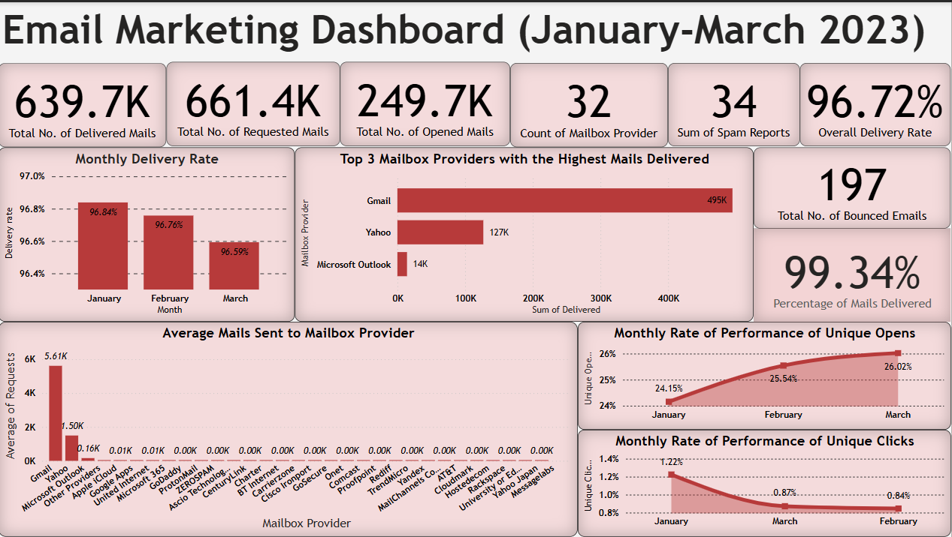

Slide 6
KPI 1: Average number of mails sent to Mailbox provider
SUMMARY REPORT
The graph shows the average number of mails sent to mailbox provider with Gmail having the highest average number of mails sent to it.
The less common sites for mail delivery has close to zero average number of mails sent to it. That is why you cannot see them properly.

Slide 7
KPI 2: Monthly Rate of Delivered Mails.
SUMMARY REPORT
This is the rate at which mails are delivered monthly, and the closer the rate is to 100%, the better the delivery.
As you can see, January had the highest rate of 96.84% followed by February which had 96.76% and then March 96.59%.

Slide 8
KPI 3: Monthly Rate of Performance for Unique opens and Unique Clicks.
SUMMARY REPORT
Unique open is the number of distinct recipients who opened the email at least once.
And this graph shows the rate of unique opens along side the rate at which the links sent where clicked.

Slide 9
KPI 4: Compare Rate of Performance of Blocked mails, Bounced mails and Unsubscribed mails.
SUMMARY REPORT
With this graph, the rate of unsubscribed mails is zero as non of the mails were unsubscribed.
With blocked and bounced mails, couple of them were blocked or bounced
The mail provider blocked the most is Carrierzone followed by other providers and the mail provider bounced the most is GoDaddy followed by United Internet.

Slide 10
CONCLUSION
To conclude, out of the 643988 mails sent, 99.34% were delivered. So, it means 0.66% mails were not delivered due to maybe the recipients mailbox is full so the rest of the mails went straight into spam or maybe mails from this institution is blacklisted on certain recipients mailbox so automatically, mails will go to spam. And mailbox providers like Gmail, Yahoo, Apple Cloud, Microsoft Outlook, etc. generated the most mails delivered.
Again, Spam reports are generally low across all mailbox providers, which is good and positive sign. However, there are spikes of spam reports in the mailbox providers that generated the highest mails delivered. This means that some mails were recongnised as spam by the recipients.
Also by comparing unique clicks and opens to total clicks and opens, the ratio is relatively low. Meaning that most recipients are not engaging with the mails being delivered. This can be due to that the content or information of the mail is not engaging or pleasing enough.

Slide 11
RECOMMENDATION
As some of the Mailbox Providers have low rate of mails delivered as most of them go to spam mails, bounced mails, deferred mails, and blocked mails. I recommend ways of preventing low delivery of mails. Ways like:
Ensuring the email addresses are well spelt to avoid the mails being deferred.
Avoidance of too much use of words like ‘free’, ‘urgent’, and ‘buy now’.
Also avoid the use of too many exclamation marks as they can be read as spam.
Balance the use text and images. Too much text is fine but too much images will somehow look suspicious.
Minimize sending too many mails as they may be blocked.
Make sure the mails being sent meets the security requirements of the company or business.
Lastly and optionally, check other companies and see how they do theirs as it can help strengthen your rate of deliverance.
On the other hand, Mailbox providers such as Gmail, Yahoo, Apple Cloud, and Microsoft Outlook, have a high rate of mails delivered. And as a data analyst, I will recommend that, you keep on using your technique but improving on how to reduce bounced, deferred, blocked, and spam mails.

Slide 12
END

